Slide 1
Foundations of Data Science & Analytics DSCI 633, Fall 2021
Lecture 22
(material sources cited in last slide)
Nidhi Rastogi
Assistant Professor, GCCIS, RIT
November 09, 2021

Slide 2
Course Information
GitHub link - https://github.com/aiforsec/RIT-DSCI-633-FDS
Reach out to TA/ Instructor during office hours, via Slack, or email for any questions, suggestions, concerns, or general chat about data science.

Slide 3
Training with TensorFlow

Slide 4
Topics Covered
Quick tour of TensorFlow
Tensors
Using TF like numpy
TensorFlow functions

Slide 5

Introduction
TensorFlow is an open-source library for Deep Learning
enables mathematical operations
allows performance optimization on CPU, GPU…
Developed by the Google Brain team and released in November 2015
Version 1.0.0 was launched in February 2017
TensorFlow 2.0 was released in September 2019

Slide 6
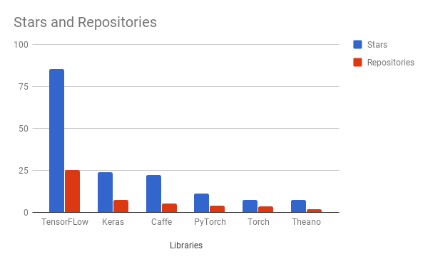
Why TensorFlow
Flexible and scalable
Popular
GitHub repositories as of Jan’20
Notes:
Most popular Deep Learning library

Slide 7
Key Features of TF
Uses tensors to perform the operations.
In TensorFlow, you first define the activities to be performed (build the graph), and then execute them (execute the graph). This allows the process to be optimized to the task at hand, reducing greatly the computation time.
Enables code to be run in parallel or on one or more GPUs.

Slide 8
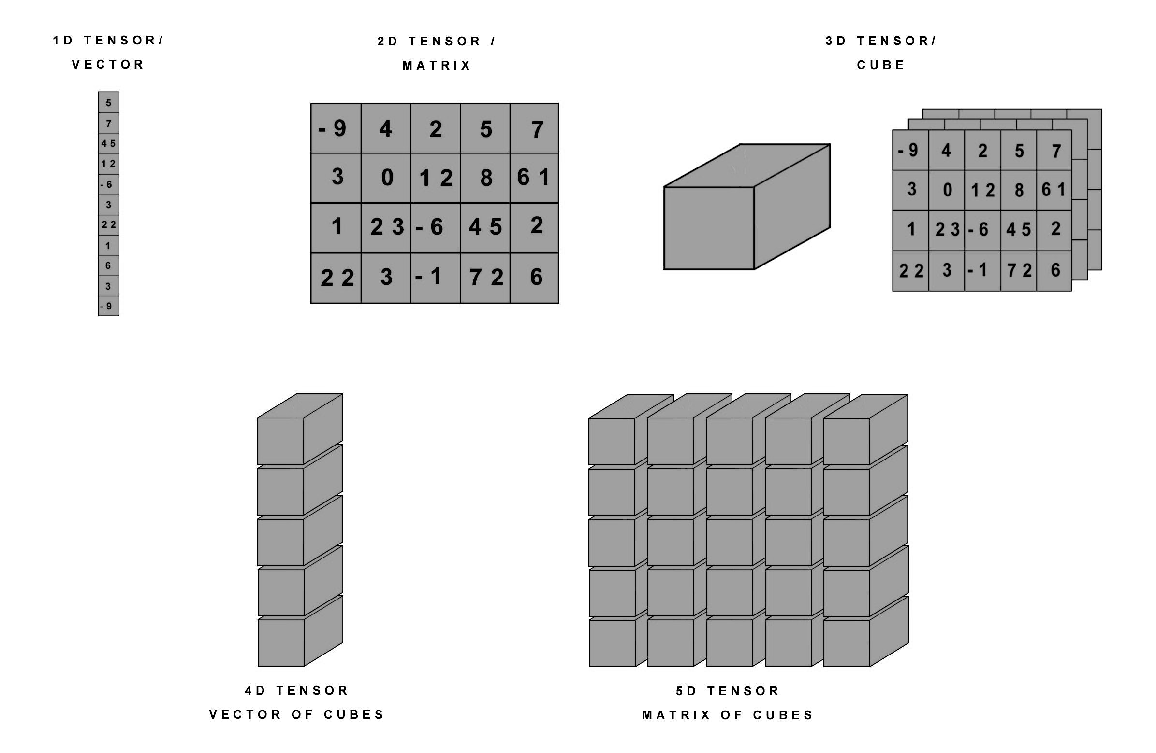
What’s a Tensor
In AI, Tensors can be understood as containers of numbers

Slide 9


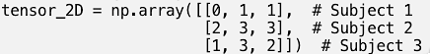
Tensors in Practice (example use cases)
0D (scalar) : Storing average grade of a course for a student
1D: Storing grades of every course student takes
2D: Storing grades of every exam taken for that course by the student

Slide 10
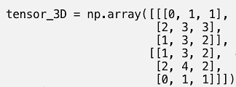
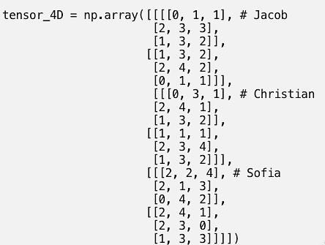
Tensors in Practice (example use cases)
3D: Storing grades of subjects (which are annual) for 2 semesters
4D: Storing grades per term of each subject for each student.

Slide 11
You could go on.. adding dimensions to tensors to store more multidimensional data

Slide 12
Common Data Stored in Tensors
3D: Time series
4D: Images
5D: Videos
https://hackernoon.com/learning-ai-if-you-suck-at-math-p4-tensors-illustrated-with-cats-27f0002c9b32

Slide 13
Common Data Stored in Tensors
3D: Time series
4D: Images
5D: Videos
Common thread among these n-dim tensors: Sample size
Typically, the actual data will be one less the sample_size:
rest_of_dimensions - sample_size = actual_dimensions_of_data
https://hackernoon.com/learning-ai-if-you-suck-at-math-p4-tensors-illustrated-with-cats-27f0002c9b32

Slide 14
Dimensions in tensors
For example, an image is really represented by three fields, like this
But we do not work with a single image or document in ML. We have a set of n samples. Example images of 10,000 tulips.
(width, height, color_depth) = 3D
(sample_size, width, height, color_depth) = 4D
https://hackernoon.com/learning-ai-if-you-suck-at-math-p4-tensors-illustrated-with-cats-27f0002c9b32

Slide 15
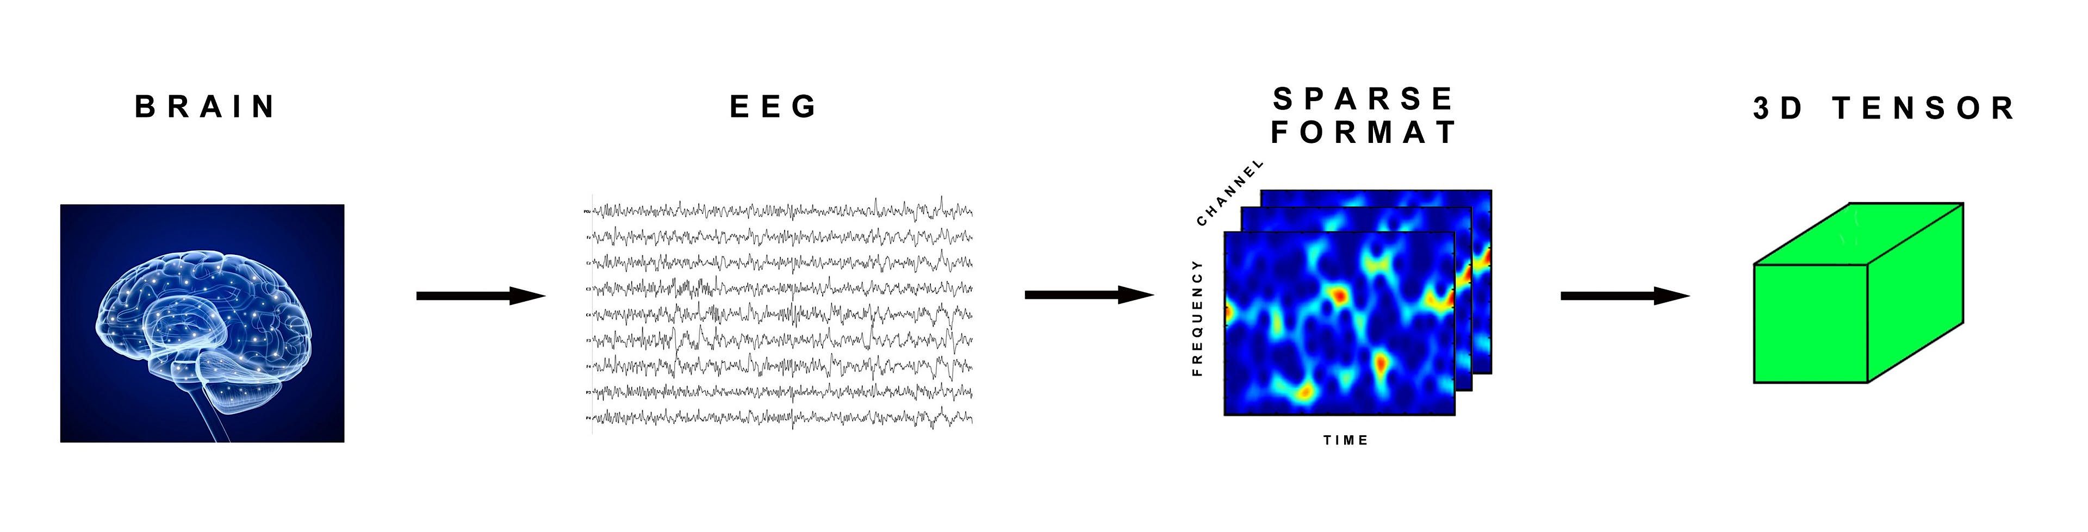
3D tensors (medical scans)
Example of Medical scans- We can encode an EEG signal from the brain as a 3D tensor, because it can be encapsulated as 3 parameters:
(time, frequency, channel)
The transformation would look like this:
https://hackernoon.com/learning-ai-if-you-suck-at-math-p4-tensors-illustrated-with-cats-27f0002c9b32

Slide 16
3D tensors (medical scans)
For multiple patients with EEG scans, we get a 4D tensor like this:
(sample_size, time, frequency, channel)
https://hackernoon.com/learning-ai-if-you-suck-at-math-p4-tensors-illustrated-with-cats-27f0002c9b32

Slide 17
3D tensors (text data)
For multiple tweets that are 140 characters. Twitter uses UTF-8 standard but we’re interested in the first 128 characters only. A single tweet can be encapsulated as a 2D vector of shape (140,128)
1 million tweets would be stored as a
3D tensor
(number_of_tweets, tweet, character) → (1000000, 140,128)
https://hackernoon.com/learning-ai-if-you-suck-at-math-p4-tensors-illustrated-with-cats-27f0002c9b32

Slide 18
Key attributes of tensors
A tensor is defined by three key attributes:
Number of axes (rank) - A 3D tensor has 3 axes, matrix has two
Also called tensor’s ndim in Python libraries such as Numpy
Shape - This is a tuple of integers that describes how many dimensions tensor has along each axis.
matrix example has shape (3, 5), 3D tensor has (3, 3, 5), vector has a shape with a single element, such as (5,), scalar has empty shape, ().
Data type (called dtype in Python libraries) - type of data contained in tensor
float32, uint8, float64, ...
no string tensors in Numpy (or in most other libraries)
https://medium.com/analytics-vidhya/data-representations-for-neural-networks-tensor-vector-scaler-basics-4beae5910398

Slide 19
Back to TensorFlow
Open-source library for ML developed by Google
Consists of both High-level API and Low level API
Useful when you need extra control to write
custom loss functions
custom metrics
layers, models, initializers, regularizers, weight constraints
fully control training loop itself, for example to apply special transformations or constraints to the gradients (beyond just clipping them), or to use multiple optimizers for different parts of the network.

Slide 20
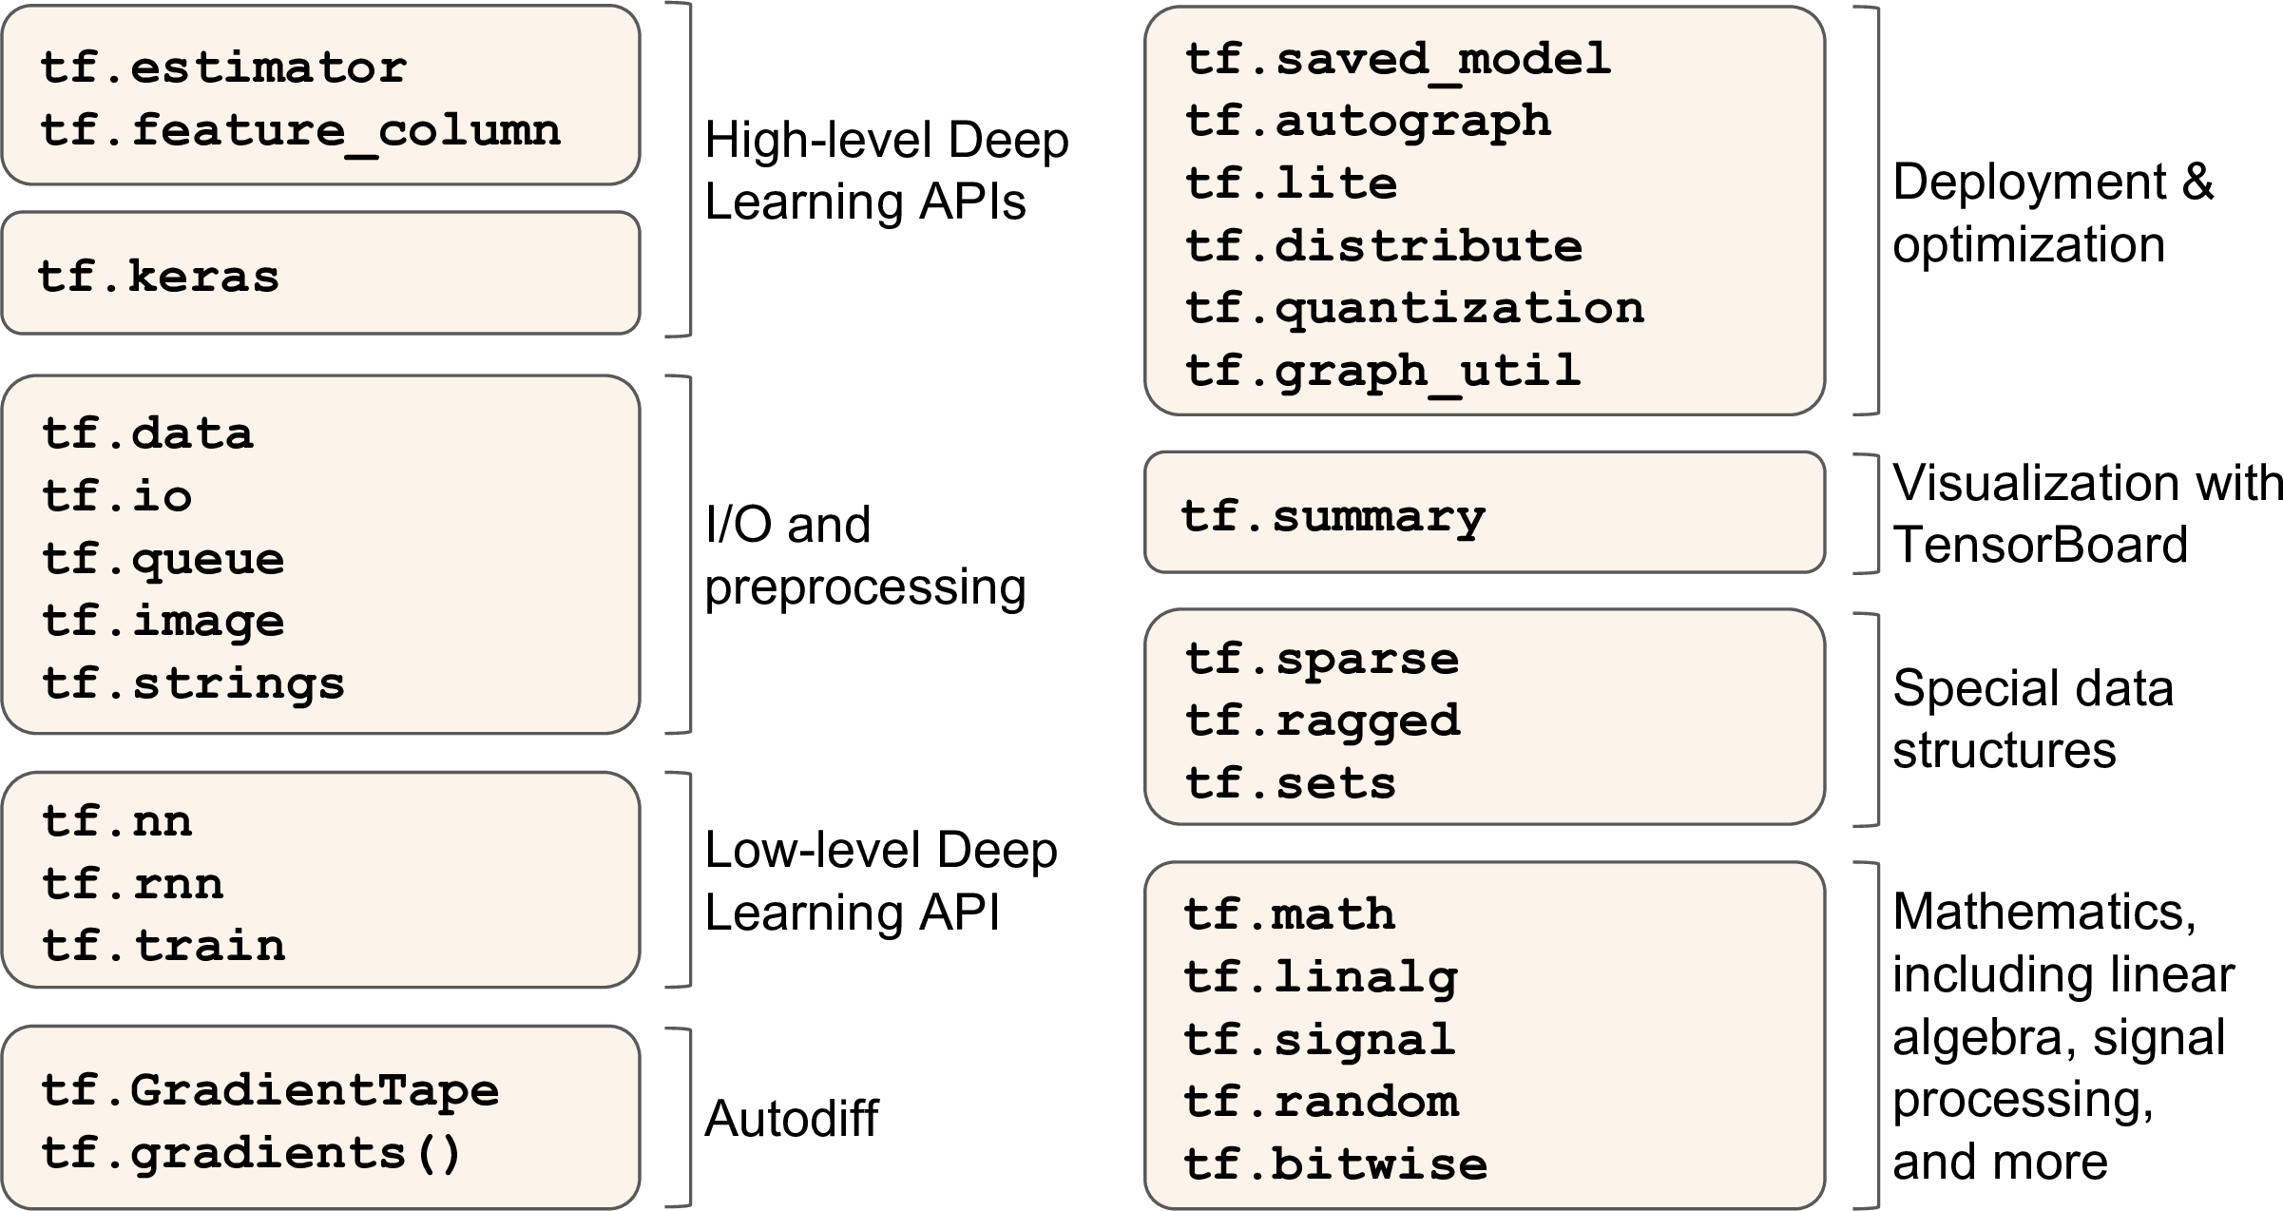
TensorFlow’s Python API

Slide 21
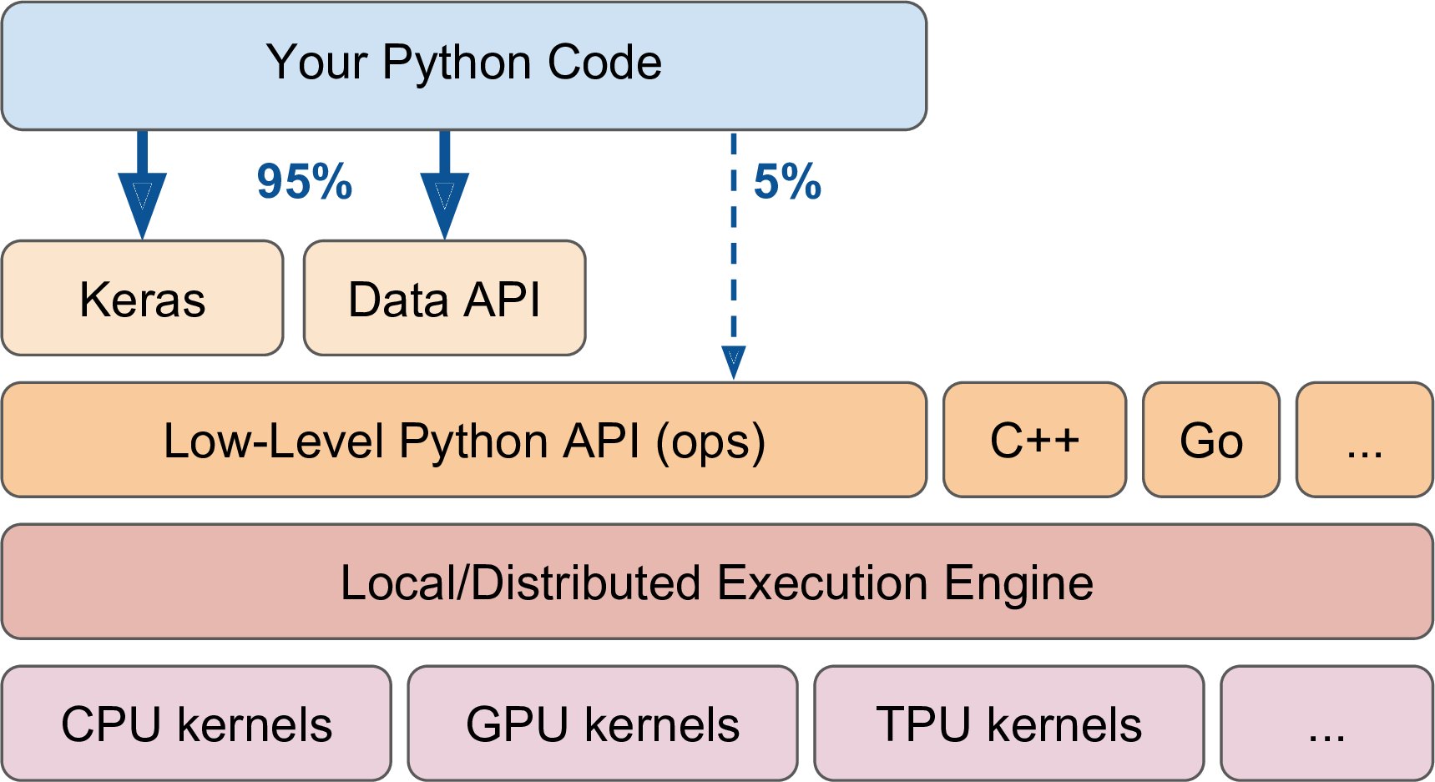
TF Architecture
Notes:
most of the time your code will use the high level APIs (especially tf.keras and tf.data), but when you need more flexi‐ bility you will use the lower level Python API, handling tensors directly. Note that APIs for other languages are also available. TensorFlow runs not only on Windows, Linux, and MacOS, but also on mobile devi‐ ces (using TensorFlow Lite), including both iOS and Android (see ???). If you do not want to use the Python API, there are also C++, Java, Go and Swift APIs. There is even a Javascript implementation called TensorFlow.js that makes it possible to run your models directly in your browser.
At the lowest level, each TensorFlow operation is implemented using highly efficient C++ code2. Many operations (or ops for short) have multiple implementations, called kernels: each kernel is dedicated to a specific device type, such as CPUs, GPUs, or even TPUs (Tensor Processing Units). As you may know, GPUs can dramatically speed up computations by splitting computations into many smaller chunks and running them in parallel across many GPU threads. TPUs are even faster. You can purchase your own GPU devices (for now, TensorFlow only supports Nvidia cards with CUDA Compute Capability 3.5+), but TPUs are only available on Google Cloud Machine Learning Engine (see ???).3

Slide 22
Basic Operations of TensorFlow
TensorFlow has a model of computation that revolves around the use of graphs.
A TensorFlow graph contains edges and nodes, where the edges are tensors and the nodes are operations.
Graph is called computational graph

Slide 23
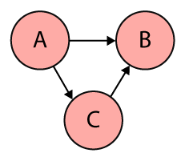
Computational Graphs
Abstract way of describing computations as a directed graph
Directed graph is a data structure consisting of nodes (vertices) and edges
set of vertices connect pairwise by directed edges
nodes in a computational graph mostly represent operations, variables, or placeholders.

Slide 24
Computational Graphs
Operations create or manipulate data according to specific rules
In TensorFlow rules are called Ops, short for operations.
Variables represent shared, persistent state that can be manipulated by running Ops on those variables.
Edges carry information from one node to another
output of one operation (one node) becomes the input to another operation and the edge connecting the two nodes carry the value.

Slide 25
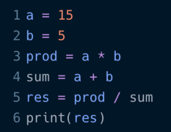
Example to create computational graph
create nodes for each operation
input variables a and b
If one node is used as input to another operation we draw a directed arrow that goes from one node to another.

Slide 26
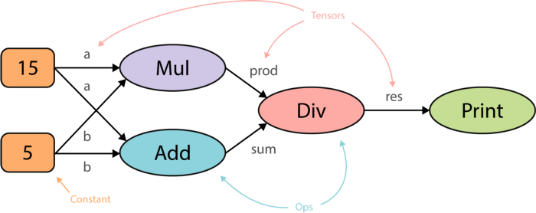
Example to create computational graph
create nodes for each operation
input variables a and b
If one node is used as input to another operation we draw a directed arrow that goes from one node to another.

Slide 27
Why we need computational graphs
Advantages of organizing computations as a directed graph:
abstract way of describing a computer program and its computations
computer programs are mainly composed of two things — primitive operations and an order in which these operations are executed, often sequentially, line by line
Computational graphs specify the dependencies across the operations. Or, how would the output of these operations flow from one operation to another.

Slide 28
Why we need computational graphs
Dependencies allow for parallelism
- also called dependency driving scheduling
We use topology of graph to drive scheduling of operations and execute them in the most efficient manner
- e.g. using multiple GPUs on a single machine or even distribute the execution across multiple machines
Which component of DL does this?

Slide 29
Parallelism
TensorFlow does exactly this
Assign operations that do not depend on each other to different cores with minimal input from humans
just by constructing a directed graph

Slide 30
Why we need computational graphs
Portability
graph is a language-independent representation of code
We can build a graph in Python, save the model and restore it in a different language, say C++, if you want to go really fast

Slide 31
Coding Exercise

Slide 32
Attributions
Some of these slides are based on material from Hands-On Machine Learning, 2nd Edition, some search on Internet...
Coding exercise are from the text book and from Kaggle.com (it’s best place to practice!)

